Slide 1
Case Study 1
Apache Spark Shuffling, Narrow vs. Wide Transformations, And 2 Coding Problems

Slide 2
What is Shuffling?
Redistribution of data across partitions
Allows for the management of records that need to be together within memory (same keys placed into same partition)
High-level:
Triggered by methods/operations:
groupByKey, reduceByKey, join, distinct, repartition, sortByKey
Low-level:
1. Shuffle Write: Each executor writes its data to disk, organized by destination partition/key
2. Network Transfer: Data moves across the cluster so matching kys land on same executor
3. Shuffle Read: Receiving executors read data back in to build new partitions

Slide 3
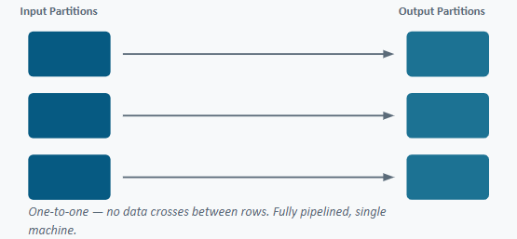
Narrow Transformations
Each output partition depends on exactly 1 input partition
Common examples:
map(), filter(), flatMap(), union()

Slide 4
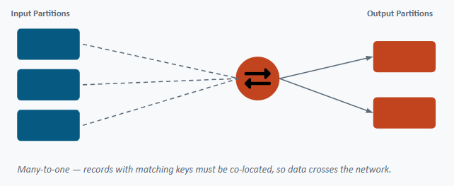
Wide Transformations
Each output partition may depend on MANY input partitions
Common examples:
join(), groupByKey(), reduceByKey(), repartition()

Slide 5
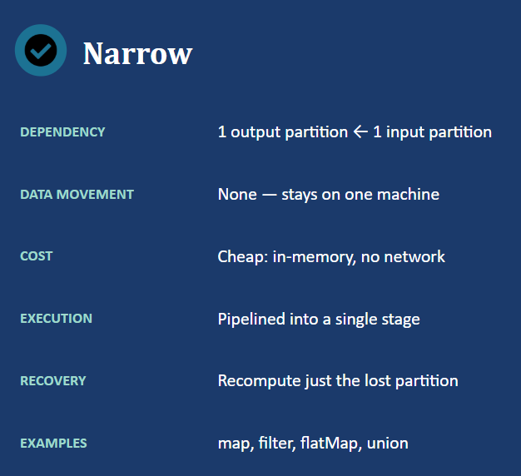
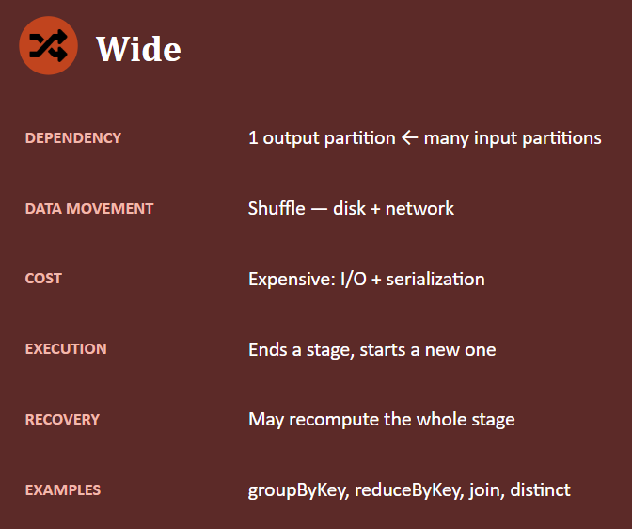
Narrow Vs. Wide

Slide 6
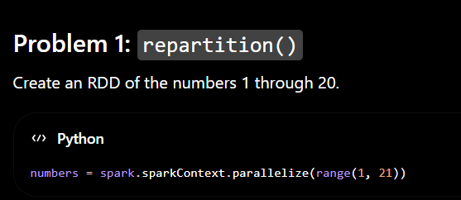
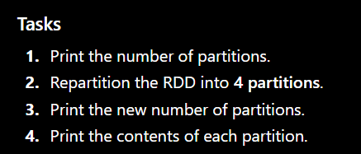

Slide 7
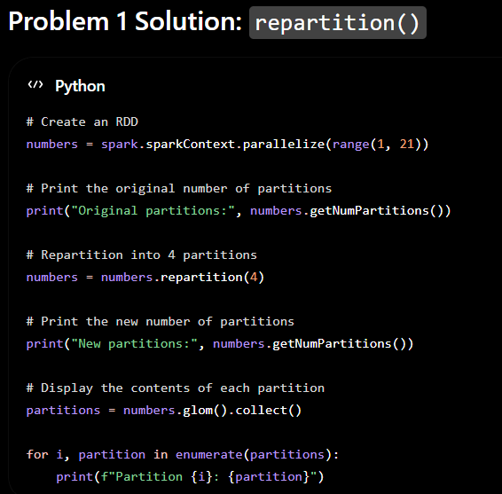
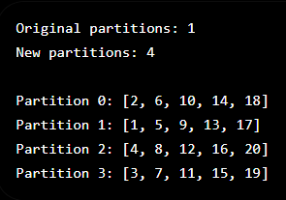

Slide 8
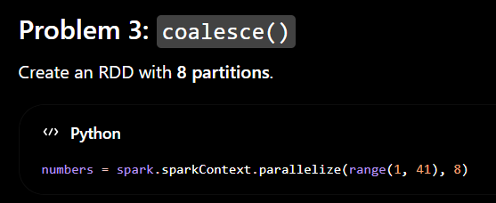
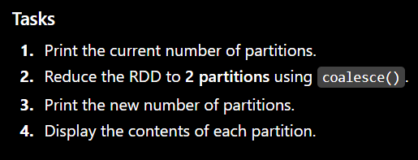

Slide 9
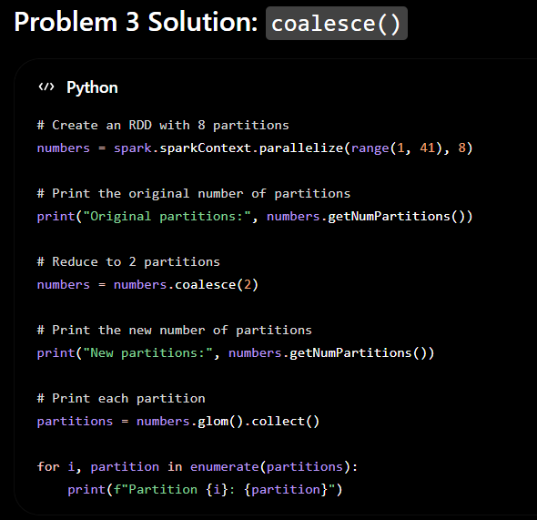
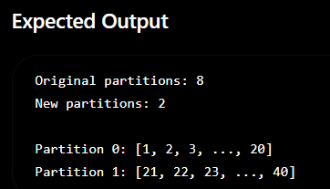
The exact grouping may differ slightly, but unlike repartition(), coalesce() tries to avoid a full shuffle and generally combines existing partitions together.

